Slide 1
School systems
B.Csiszár
S.Theis
In: Slovakia
United Kingdom
U.S.A.

Slide 2
School System of Slovakia
__________________________________________ | kindergarden | Primary School First Grade | Primary School Second Grade | High School | University
AGE: | 3-5 | 6-9 | 10-14 | 15-19 | 20-25
LEARNING TIME: | 8:00 -14:00 | 8:00 – 12:25 | 8:00 – 13:15 | 8:00 – 14:30 | __________________________________________
PAYMENT: | free | free | free | free | free
These types of school can be private too, so they have to pay.

Slide 3
Primary Schools
pupils starts day in school straight with learning. When a teacher comes to class pupils stand up.
There are often 5 min.,10 min. and 15 min. breaks between lessons.
Learning from morning Monday to Friday
School subjects: Slovak language, Literature, English, German/Russian l., Chemistry, Physics, Technic, Art, Music, History, PE, ICT, Maths, Geography, Biology

Slide 4
High school
After Primary school pupils can pick their high school according they want to do. So every school got different subjects. In the end of High school they have to do graduation tests, if they succed they got a graduation prom together.
Grammar School
After Primery school they also can choose a grammar school, where they study same subjects, which the study in Primary school.

Slide 5
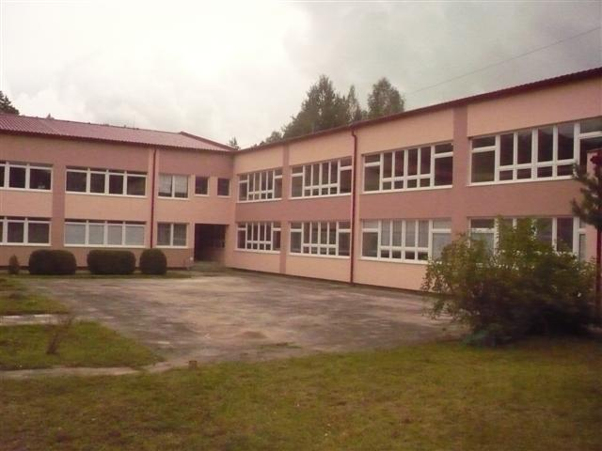
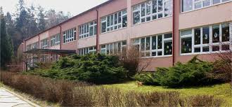
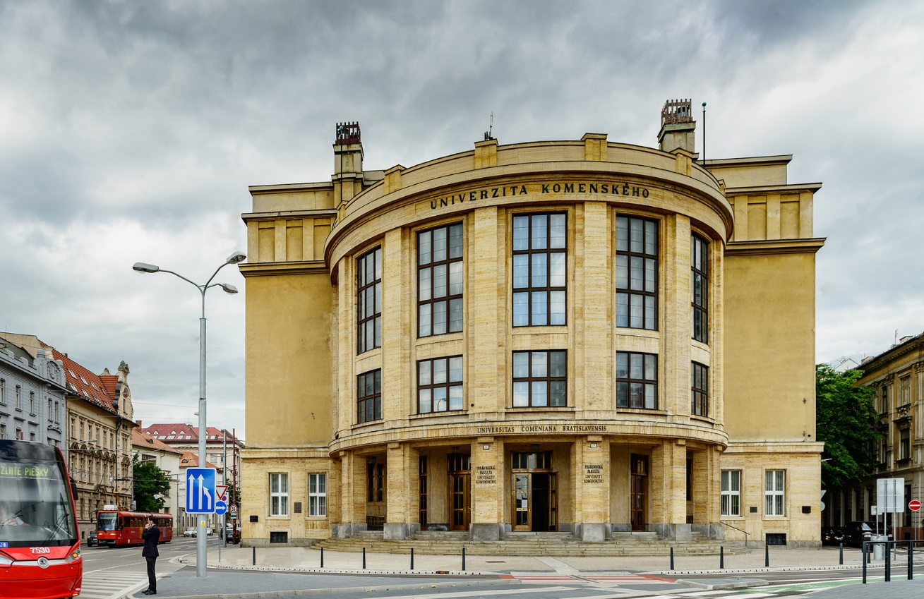
Our school: PS with KG Prakovce
University of Komenskeho: first University of Slovakia, in Bratislava

Slide 6
School System of U.S.A.
__________________________________________ | Kindergarden | Grade School | Junior High School | Senior High School | Collage
AGE: | 5 | 6 - 10 | 11 - 14 | 15 - 18 | 19 - more
LEARNING TIME: | Half of day | 7/8:00 – 13:30/14:00 | 7/8:00 – 13:30/14:00 | 7/8:00 – 13:30/14:00 | __________________________________________
PAYMENT: | free | free | free | free | have to pay

Slide 7
Kindergarden and Grade school
They are learning basic things like writing, drawing, reading, etc.
Junior High School and Senior High School
Day they start with flag ceremony. They got subjects like English, Chemistry, Physics, Technic, Art, Music, History, PE, ICT, Maths, Geography, Biology etc.
Collage
They have to pay a collage. Students often study and work in restaurants, cinemas, shops, etc., to pay collage.
Collages are: higher vocational schools, High schools, art colleges, private colleges, Universities

Slide 8


University in USA
Harvard University-is the oldest university in the United States. They founded it in 1636.
School crest
School building

Slide 9
School System in UK
_________________ __________________________________ | Preschool | Primary Education | Secondary Education | University
AGE: | 5-7 | 7-11 | 11-16 | 16-more
LEARNING TIME: | 9:00 – 15:00 | 9:00 -15:00 | 9:00 -15:00 | ____________________________________________________________________
PAYMENT: | free | free | free | Pay

Slide 10
Preschool- this is the first two years of primary education.
Primary Education- Schools are usually mixed for boys and girls and are usually close to where children live.
Subjects: English, Maths, PE, Physics, Biology, etc.
Secondary Education- When children age 11, they go to high school. Usually this could be the school closest to their home, but parents in England may prefer another school.
Subjects: Students choose subjects from 8 to 12, they are obligatory: Maths, English, one of Science subject, IT, Citizenship.
University- British schools are top in the ranks of universities in the world, putting emphasis on the development of critical thinking.They offer an international environment, daily contact with English and many study fields!

Slide 11

School Uniforms
Girls have skirt, shirt and sweather .
Boys have shirt, sweather, traucers,
boots and tie.

Slide 12

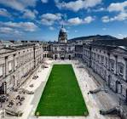
University in UK
The University of Edinburgh- was founded in 1583.
These university was founded than 6th in UK.
These university every year get 47000 registration.

Slide 13
Thank you for your attention.

